Slide 1
Study Guide CTech 230
By: Kerin Quintero

Slide 2

Access level
The set of permissions on restriction provided to a data type.

Slide 3
Access modifier
Key words that are used to specify the accessibility of a class and its members.
True or False? Are these correct access modifiers below?
Default, Private, Protected, and Public.

Slide 4
Actual parameter
Variables that are transferred to the function when it is requested.
Examples are int x, int y

Slide 5
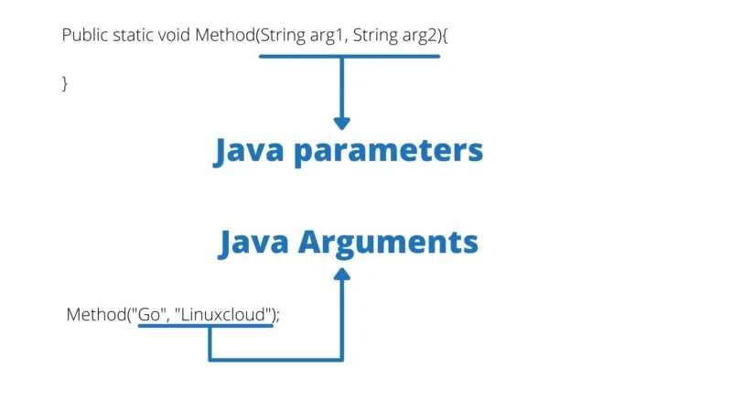
Argument
A special kind of variable used in a subroutine to refer to one or more pieces of data provided as input to the subroutine.
Differences >>>>>>>>>

Slide 6
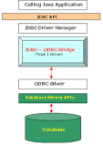
Driver
A software program that enables a specific hardware device to work with a computer’s operating system.

Slide 7
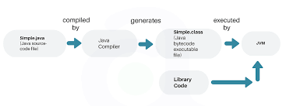
Flow of execution
The order in which statements are executed.

Slide 8
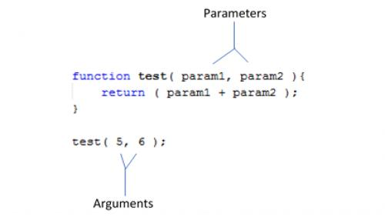
Formal parameter
A special kind of variable used in a subroutine to refer one of the pieces of data provided as input to the subroutine.

Slide 9
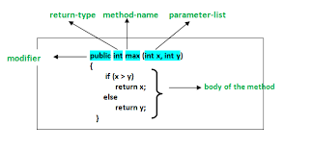
Method body
Contains the instructions that implement the method.
Does this show a great example of the body of a method?

Slide 10
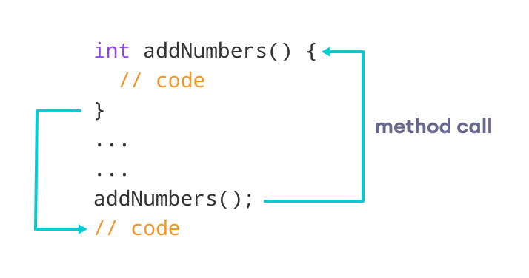
Method call
Executes a method by calling it. It is the method name followed by ()

Slide 11
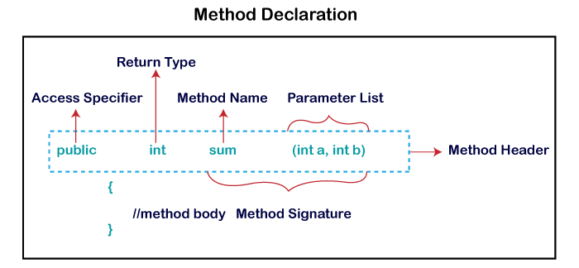
Method declaration
Defines all the methods attributes, such as access level, return type, and name.

Slide 12
Method (definition)
A set of instructions that could be called for execution while using the method name.
True or False? Is it true that these are collected statements that are grouped together to preform an operation?

Slide 13
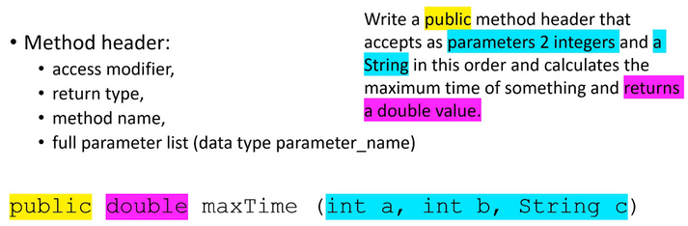
Method heading
The header is letting you know the value type if there is any in which the method will return

Slide 14
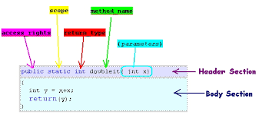
Method name
A piece of code which is referring to or by name that can also be called (invoked) at any time in a program simply by using method's name

Slide 15
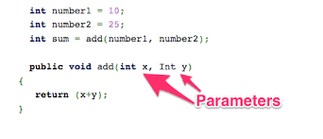
Method parameter
Values that are passed to methods to aid the methods to aid the method in carrying out its intended functionality.

Slide 16
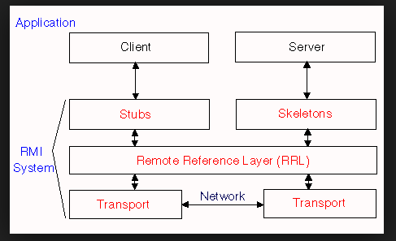
Method stub
A piece of code used to stand in for some other programming functionality in software development.

Slide 17
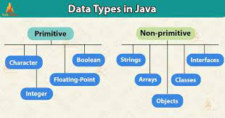
Method type
Represents the arguments and return type accepted in return by a method handle, or the arguments and return type past and affected by a method handle caller.

Slide 18
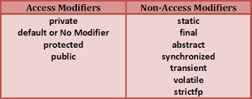
Modifier
Provides static methods and constants to decode class and member access modifiers.

Slide 19
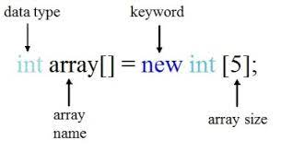
New (the operator)
Instantiates a class by allocating it a memory for an associated new object.

Slide 20
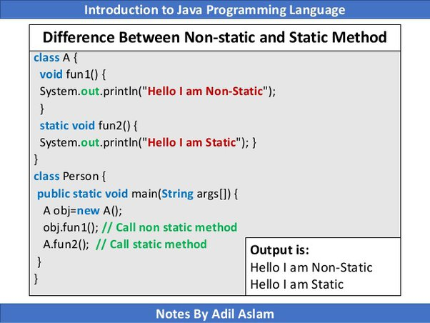
Nonstatic method
Does not have the keyword static before the name of the method.

Slide 21
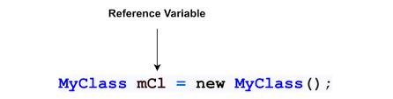
Reference variables
Play variable that holds reference of an object.

Slide 22
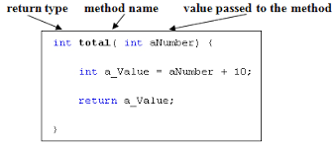
Return type
Defines and constraints the data type of the value returned from a subroutine or method.

Slide 23
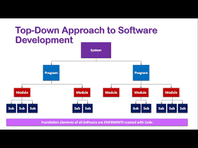
Top-down development
The focus is on breaking the bigger problem into smaller rooms, and then repeating the process with each problem.

Slide 24
Thank you

